Slide 1
Tech Layoffs: Figures & Charts
Group 1: Anitha Shivaramaiah, Brayan Murillo Gutierrez, Robert Fajardo, and Kevin Raj

Slide 2
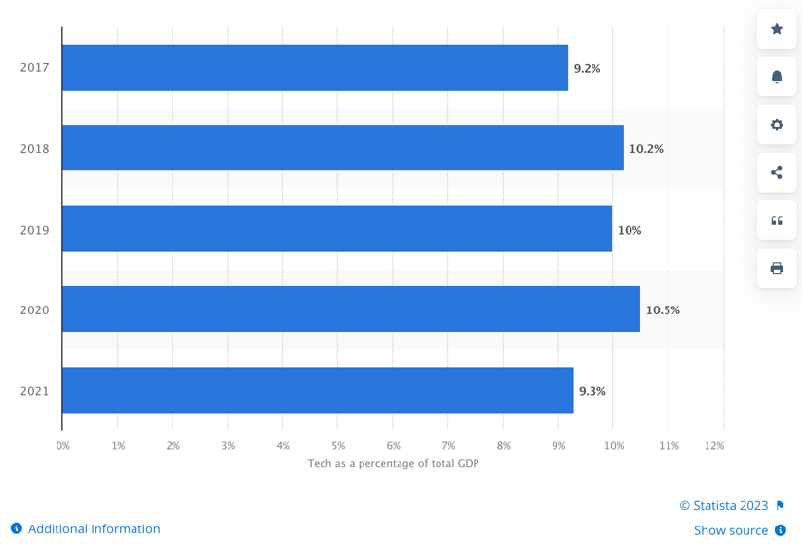
Figure 1: Tech Sector Contribution to US Gross Domestic Product

Slide 3
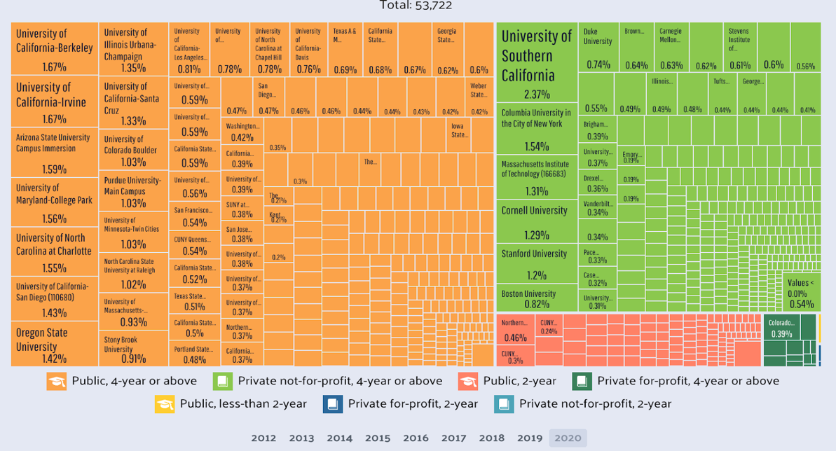
Figure 2: Data System Report for College Graduates

Slide 4
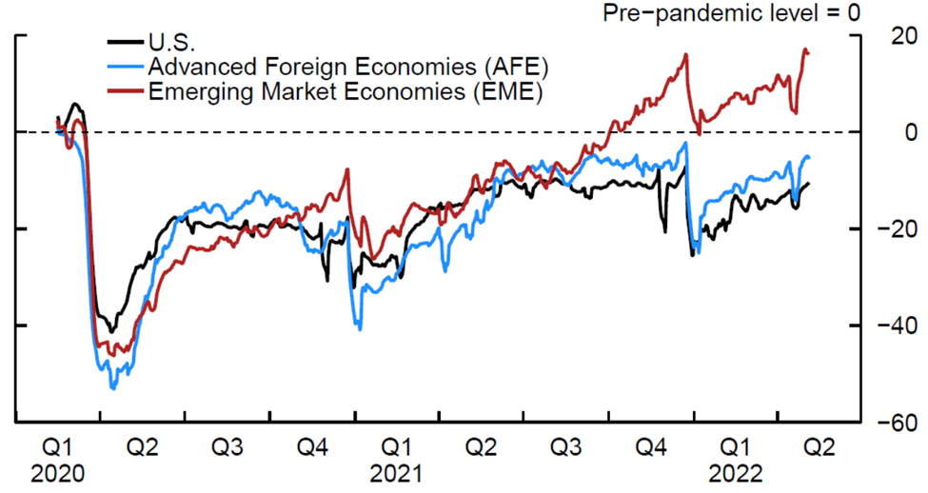
Figure 3: Mobility During the Pandemic

Slide 5
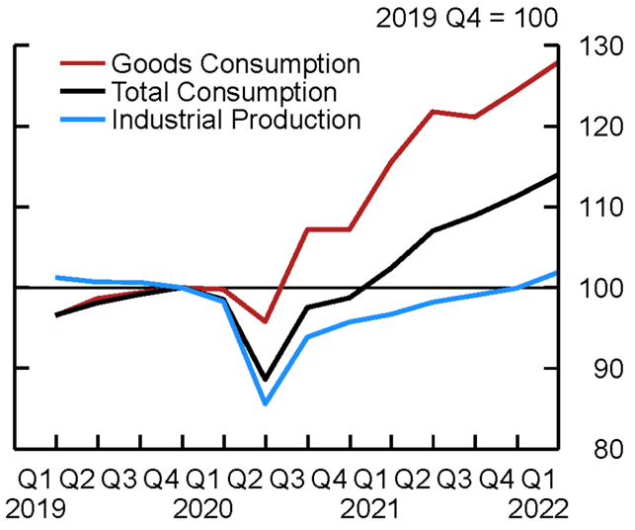
Figure 4: Demand vs Production Levels

Slide 6
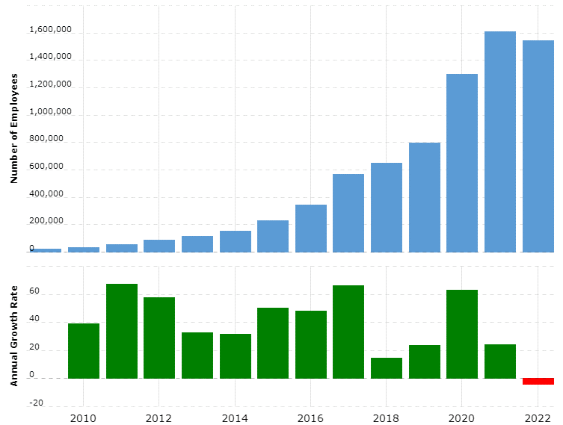
Figure 5: Annual Growth by Number of Employees in Amazon

Slide 7
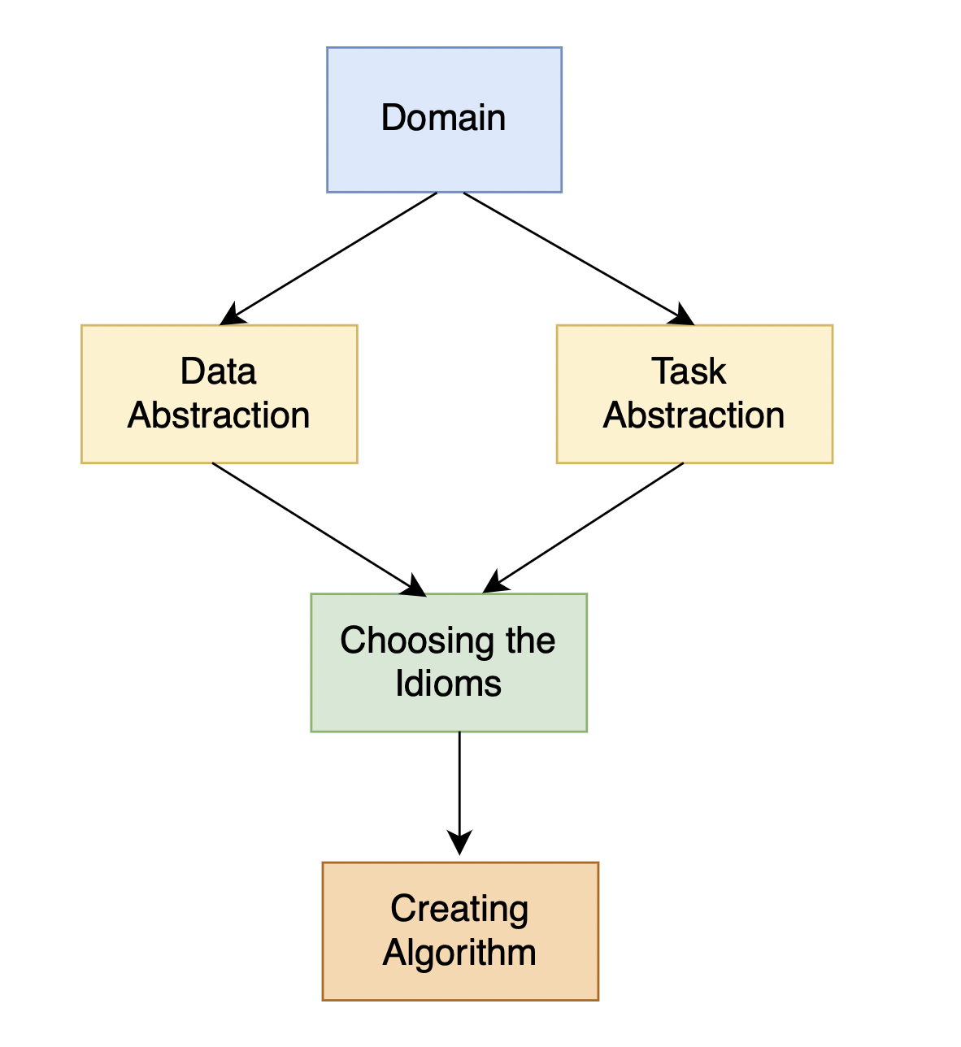
Figure 6: The Basic Flow of Visualization

Slide 8
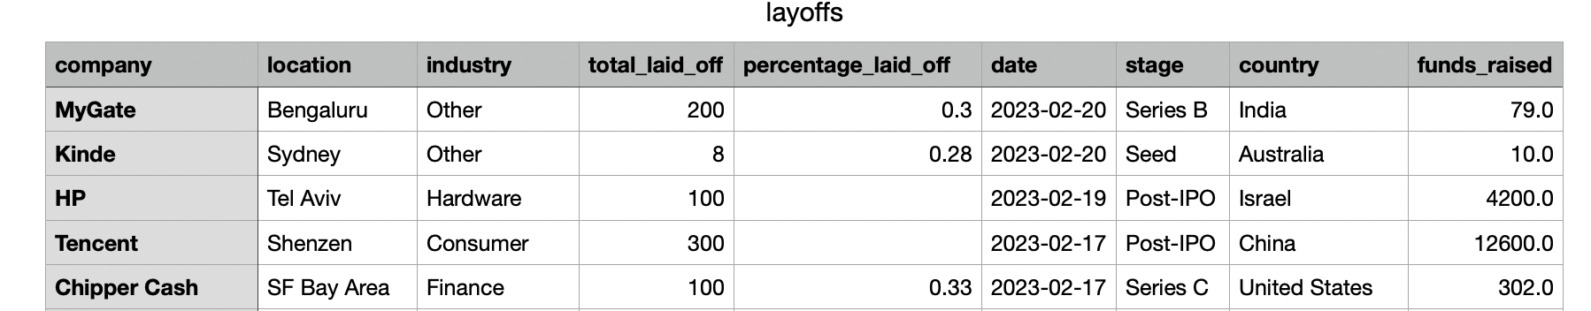
Figure 7: Tech Layoff Dataset

Slide 9
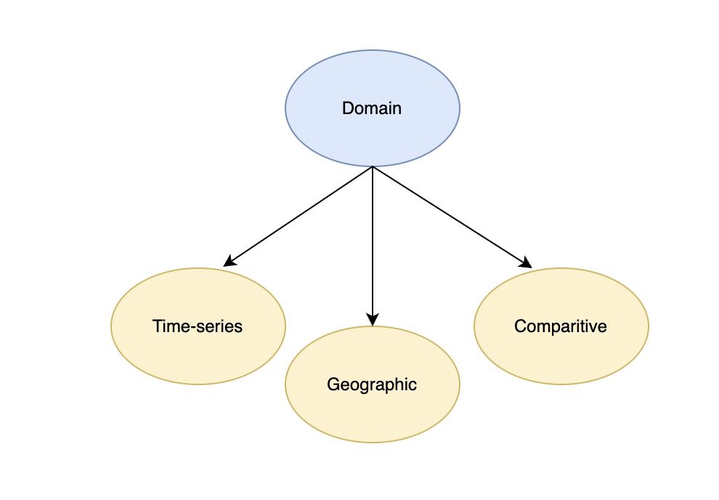
Figure 8: Domain Categories

Slide 10
Table 1: Layoff Dataset
Attribute Name | Attribute Type
company | Categorical
location | Categorical
industry | Categorical
total_laid_off | Ordinal
percentage_laid_off | Quantitative
date | Quantitative
stage | Categorical
country | Categorical
funds_raised | Quantitative

Slide 11
Table 2: BLS Dataset
Attribute Name | Attribute type | Attribute Name | Attribute type | Attribute Name | Attribute type
Date | ordinal | area_fips | categorical | oty_disclosure_code | categorical
T5YIE | quantitative | area_title | categorical | oty_qtrly_estabs_chg | quantitative
Year | ordinal | text_area_or_state_name | categorical | oty_qtrly_estabs_pct_chg | quantitative
Period | ordinal | area_fips | categorical | oty_month1_emplvl_chg | quantitative
Label | categorical | own_code | categorical | oty_month1_emplvl_pct_chg | quantitative
Value | quantitative | own_code_names | categorical | oty_month2_emplvl_chg | quantitative
1-Month Net Change | quantitative | industry_code | categorical | oty_month2_emplvl_pct_chg | quantitative
3-Month Net Change | quantitative | Inudstry_name | categorical | oty_month3_emplvl_chg | quantitative
6-Month Net Change | quantitative | agglvl_code | categorical | oty_month3_emplvl_pct_chg | quantitative
12-Month Net Change | quantitative | size_code | categorical | oty_total_qtrly_wages_chg | quantitative
1-Month % Change | quantitative | year | ordinal | oty_total_qtrly_wages_pct_chg | quantitative
3-Month % Change | quantitative | qtr | ordinal | oty_taxable_qtrly_wages_chg | quantitative
6-Month % Change | quantitative | disclosure_code | categorical | oty_taxable_qtrly_wages_pct_chg | quantitative
12-Month % Change | quantitative | qtrly_estabs | quantitative | oty_qtrly_contributions_chg | quantitative
Year | ordinal | month1_emplvl | quantitative | oty_qtrly_contributions_pct_chg | quantitative
Period | ordinal | month2_emplvl | quantitative | oty_avg_wkly_wage_chg | quantitative
Label | categorical | month3_emplvl | quantitative | oty_avg_wkly_wage_pct_chg | quantitative
Value | quantitative | total_qtrly_wages | quantitative | Year | ordinal
1-Month Net Change | quantitative | taxable_qtrly_wages | quantitative | Period | ordinal
3-Month Net Change | quantitative | qtrly_contributions | quantitative | Label | ordinal
6-Month Net Change | quantitative | avg_wkly_wage | quantitative | Value | quantitative
12-Month Net Change | quantitative | lq_disclosure_code | categorical | 1-Month Net Change | quantitative
1-Month % Change | quantitative | lq_qtrly_estabs | quantitative | 3-Month Net Change | quantitative
3-Month % Change | quantitative | lq_month1_emplvl | quantitative | 6-Month Net Change | quantitative
6-Month % Change | quantitative | lq_month2_emplvl | quantitative | 12-Month Net Change | quantitative
12-Month % Change | quantitative | lq_month3_emplvl | quantitative | 1-Month % Change | quantitative
date | ordinal | lq_total_qtrly_wages | quantitative | 3-Month % Change | quantitative
fedfunds | quantitative | lq_taxable_qtrly_wages | quantitative | 6-Month % Change | quantitative
area_fips | categorical | lq_qtrly_contributions | quantitative | 12-Month % Change | quantitative
fedfunds | quantitative | lq_avg_wkly_wage | quantitative

Slide 12
Table 3: Business Formation Dataset
Attribute Name | Attribute Type
sa | Categorical (2 classes)
naics_sector | Categorical (21 classes)
series | Categorical (12 Classes)
geo | Categorical/position (56 Classes)
year | Quantitative (2004-2023)
jan | Quantitative ( 0 - inf )
feb | Quantitative ( 0 - inf )
mar | Quantitative ( 0 - inf )
apr | Quantitative ( 0 - inf )
may | Quantitative ( 0 - inf )
jun | Quantitative ( 0 - inf )
jul | Quantitative ( 0 - inf )
aug | Quantitative ( 0 - inf )
sep | Quantitative ( 0 - inf )
oct | Quantitative ( 0 - inf )
nov | Quantitative ( 0 - inf )
dec | Quantitative ( 0 - inf )

Slide 13
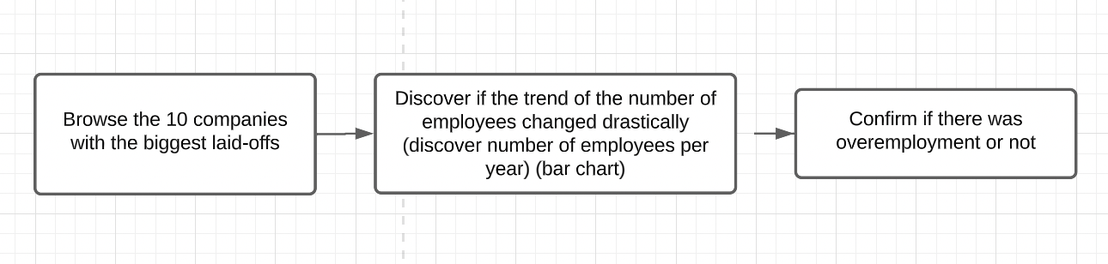
Task 1: Top 20 Company Layoffs

Slide 14
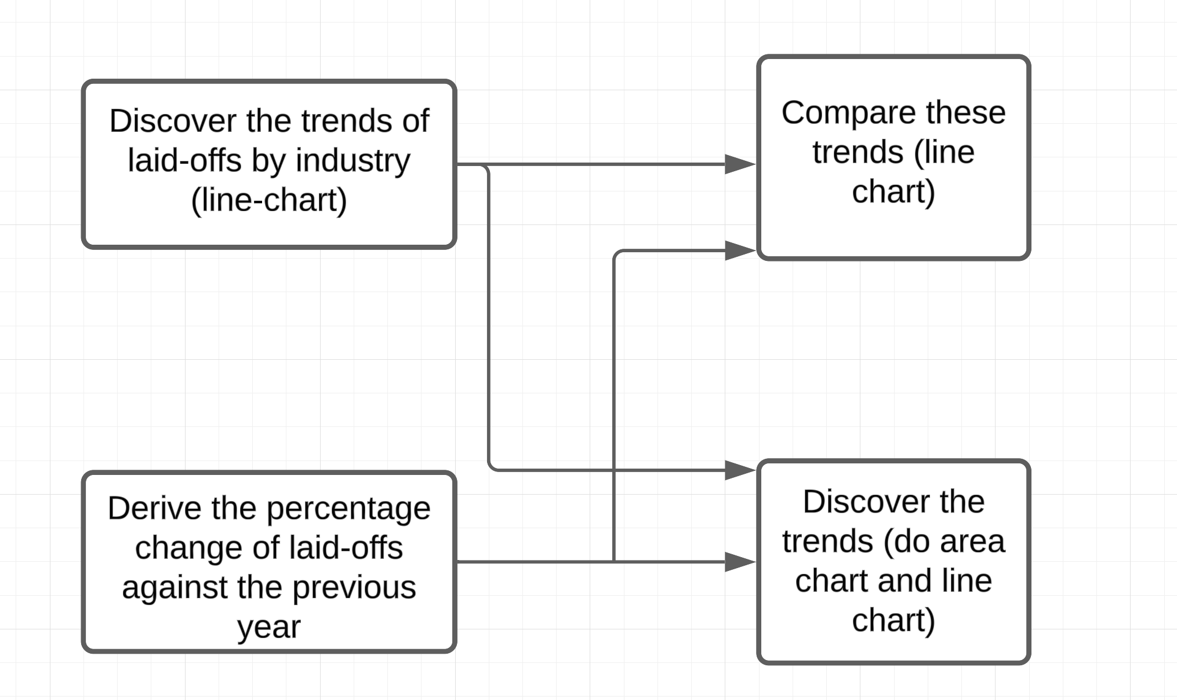
Task 2: Number of Layoffs for Each Quarter

Slide 15
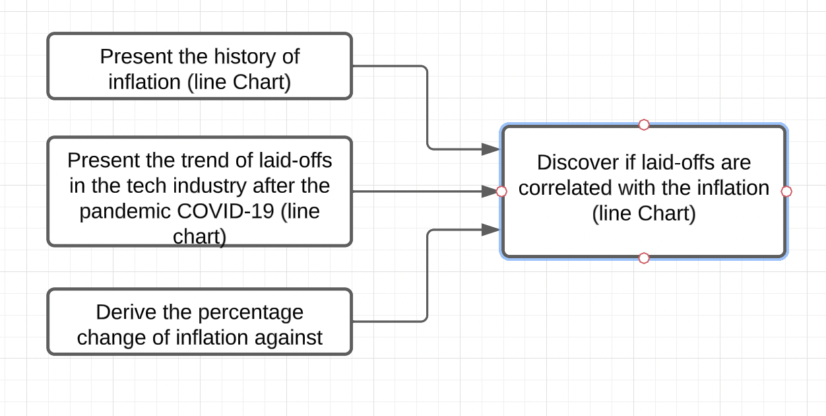
Tasks 3-6: Inflation

Slide 16
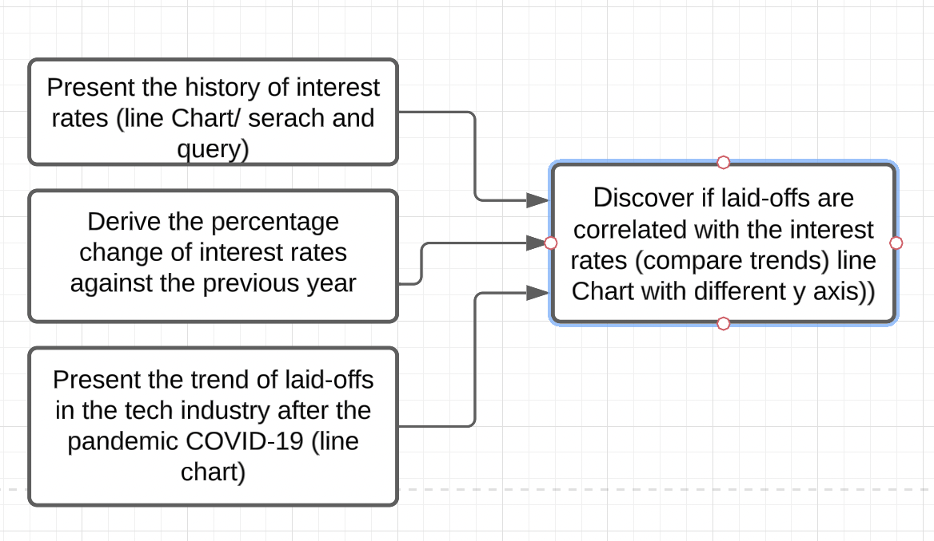
Task 7: Interest Rates

Slide 17
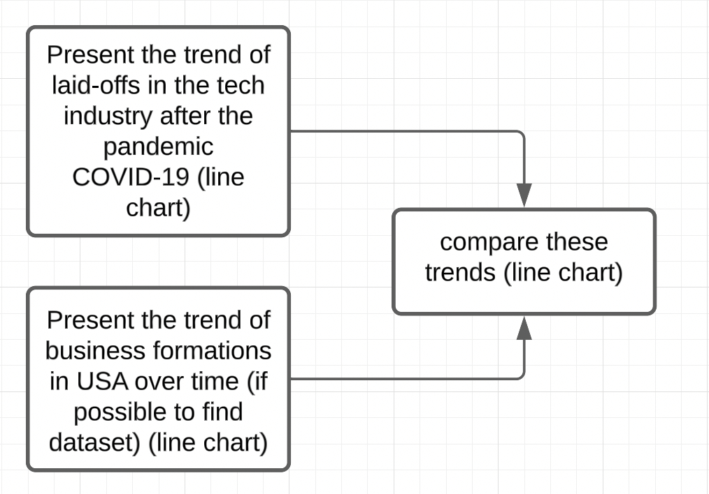
Task 8: Layoff and Start-Up Correlation

Slide 18
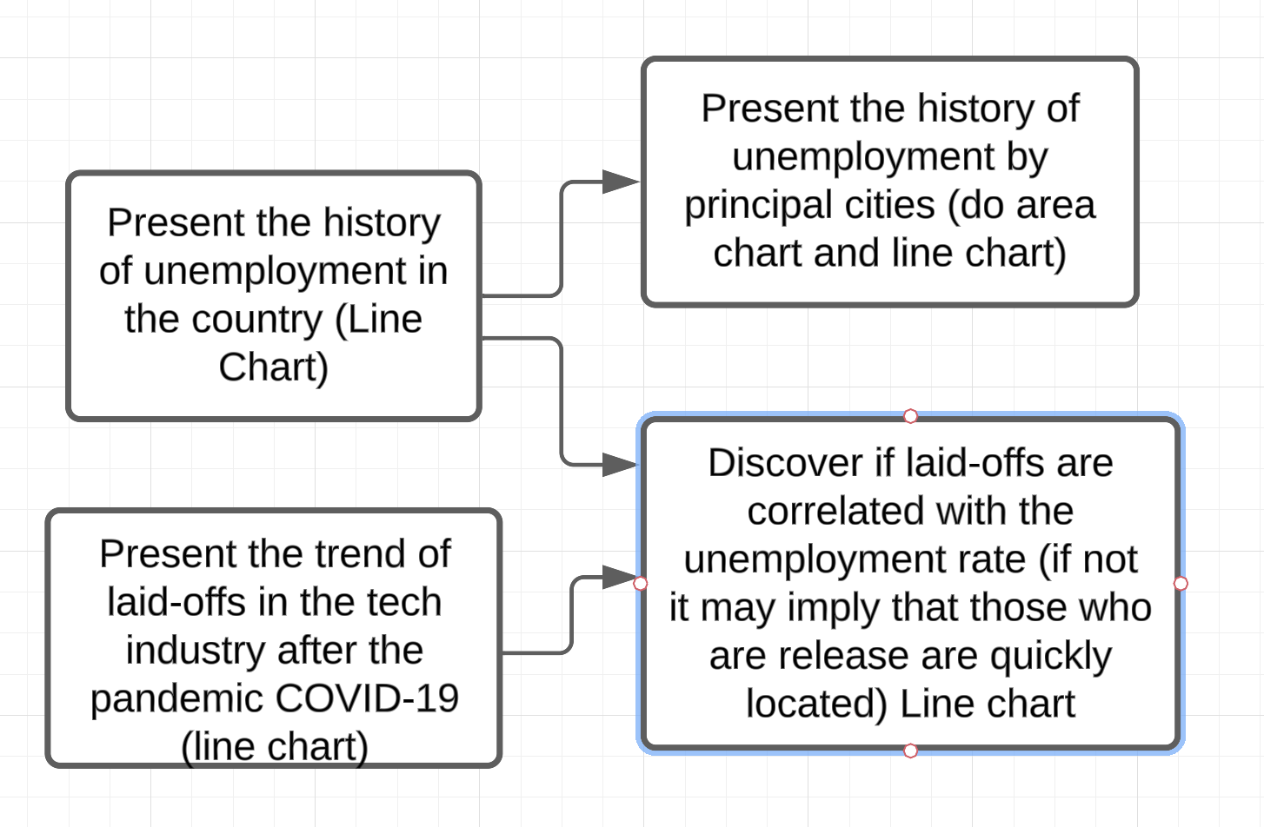
Task 9-10: Unemployment Rate

Slide 19
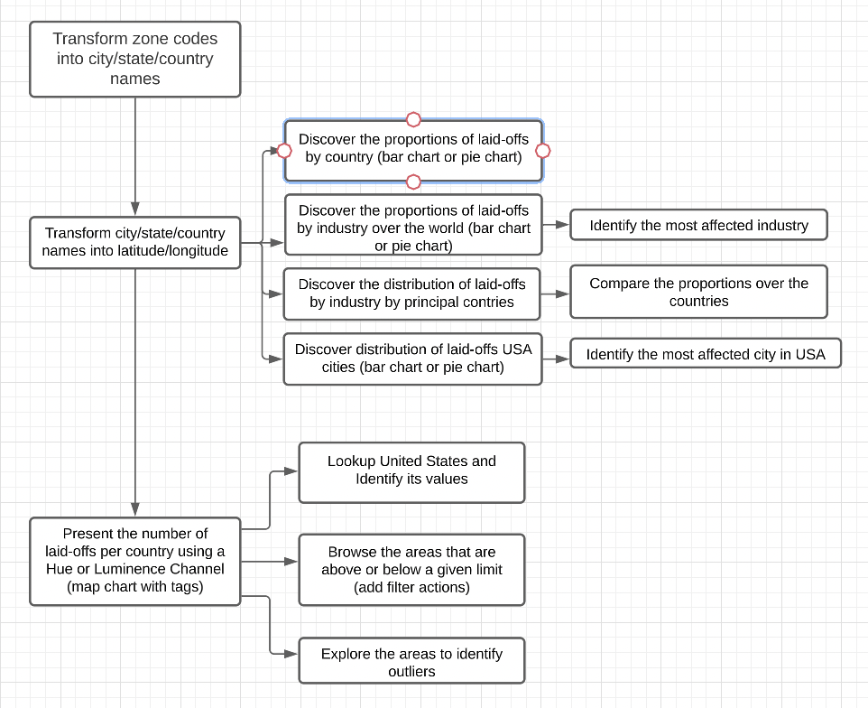
Task 11: Geographic Layoff

Slide 20
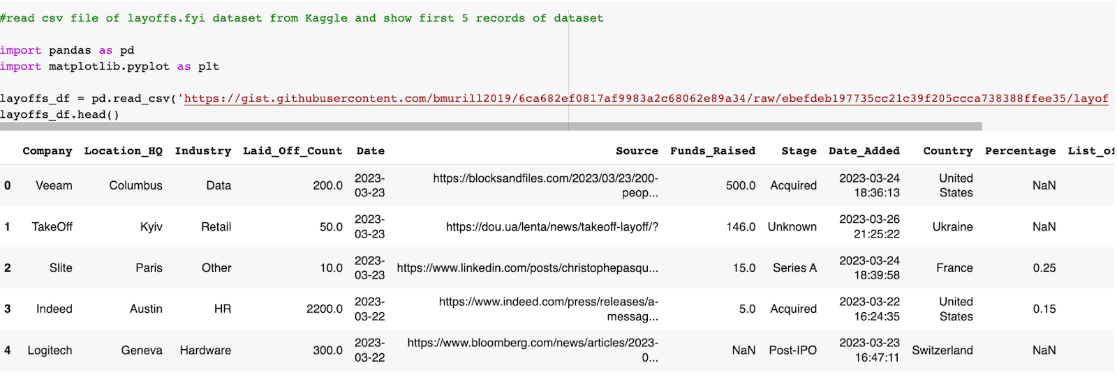
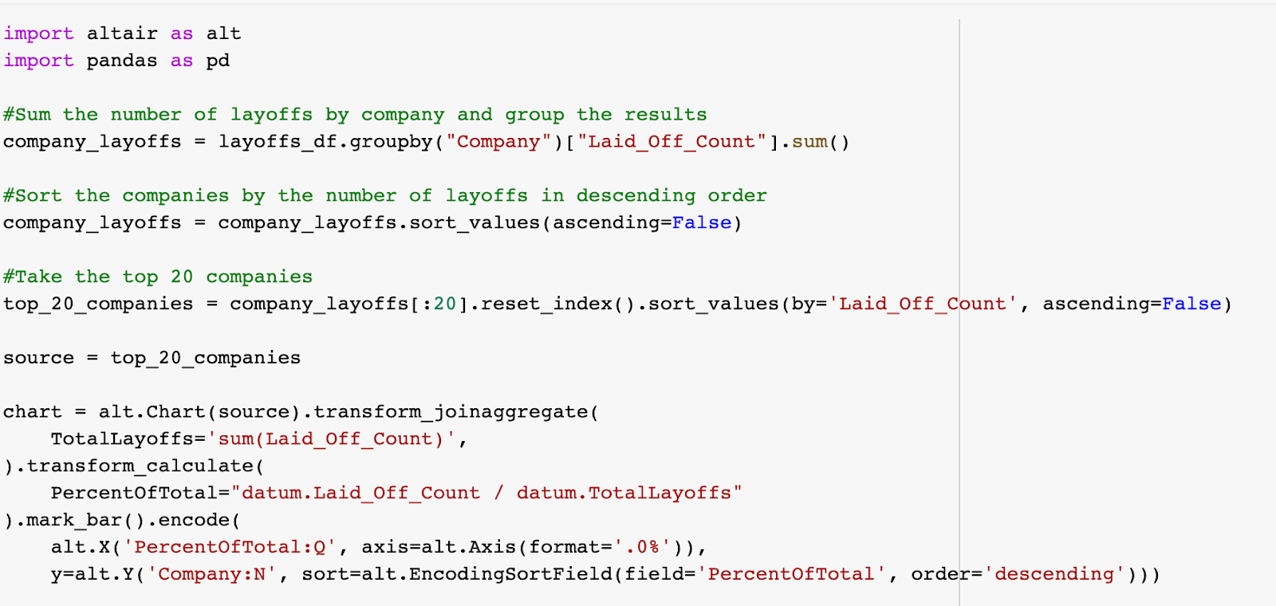
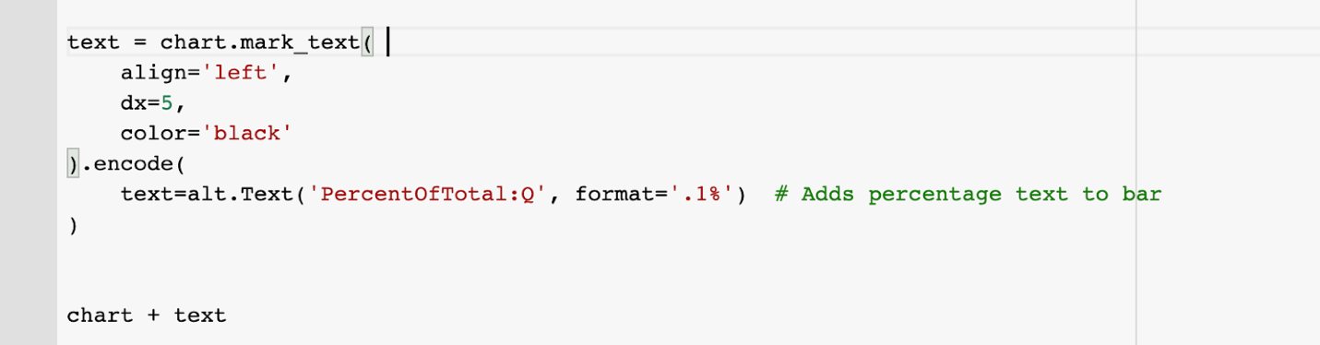
Task 1: Implementation Code (Altair/Pandas)

Slide 21
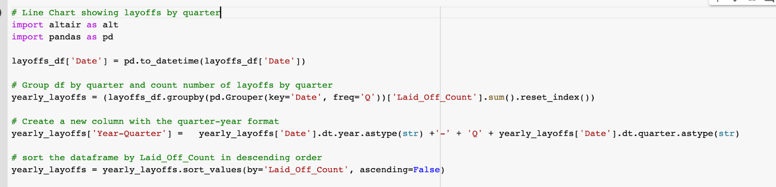
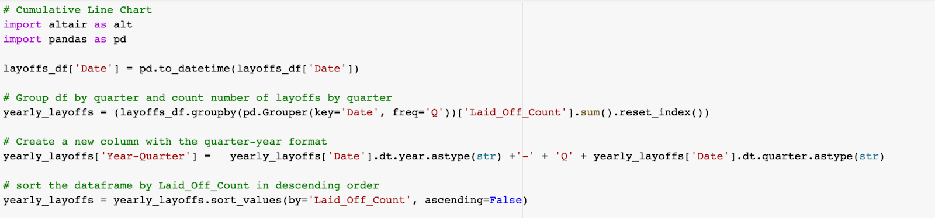
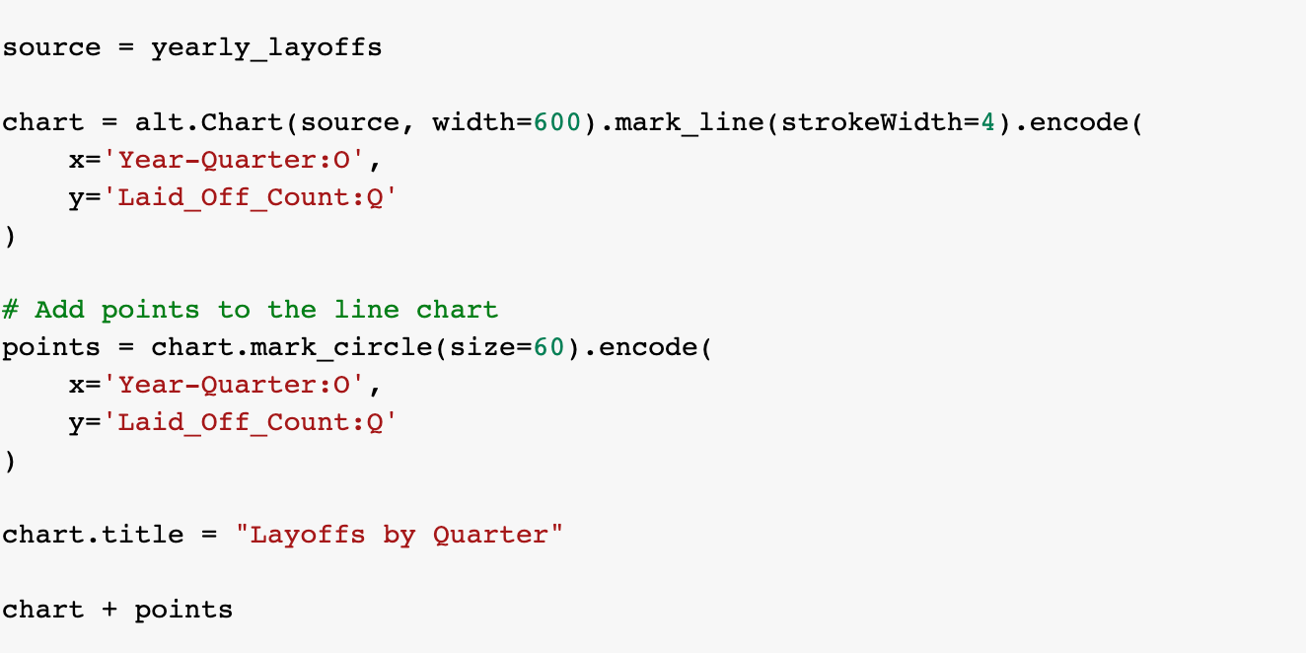
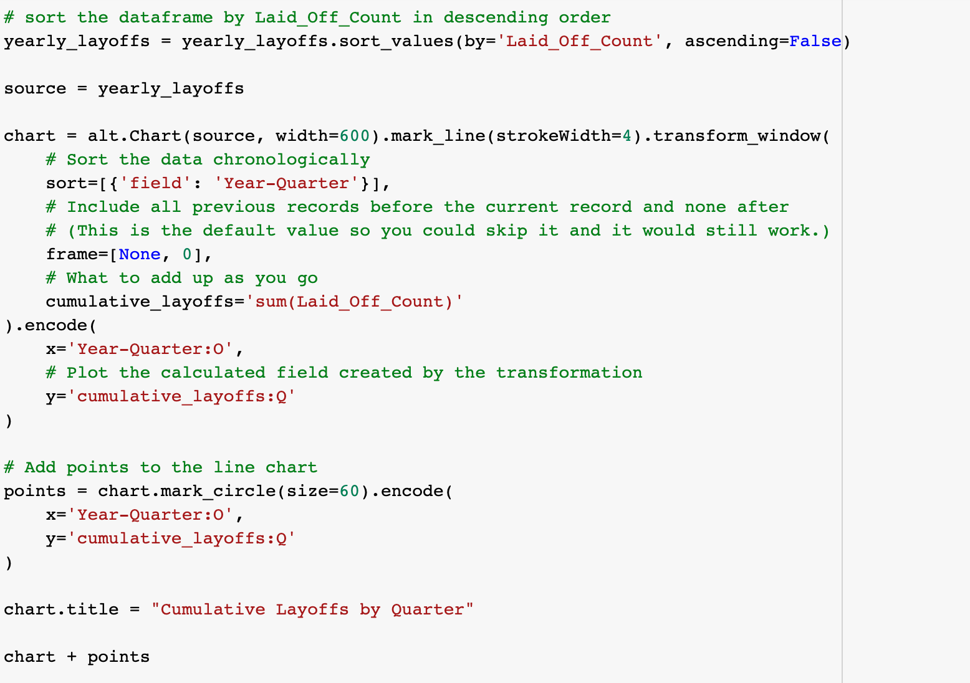
Task 2: Implementation Code (Altair/Pandas)

Slide 22
Task 2: Implementation Code (Altair/Pandas)

Slide 23
Task 3: Implementation Code (Altair/Pandas)

Slide 24
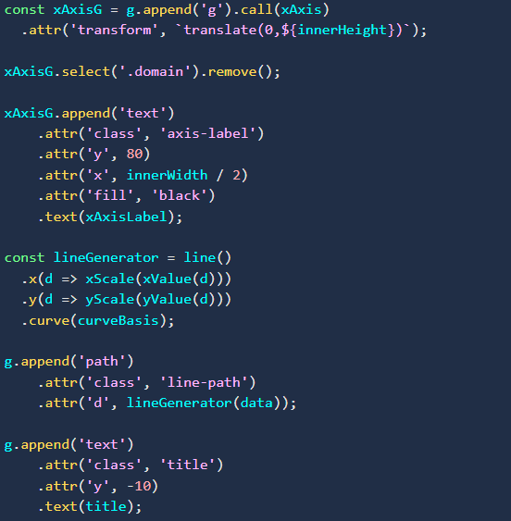
Figure 9: Line Chart Code in d3.js

Slide 25
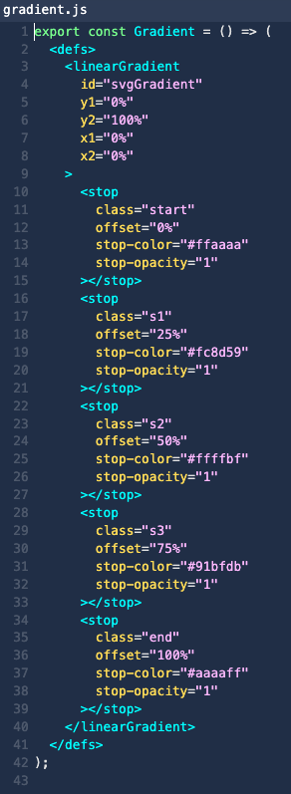
Figure 10: The linear gradient has 5 gradient colors from start to stop(finish).

Slide 26
Figure 11: Calculation of y-value min, max, avg to achieve data point colors in marks.js

Slide 27
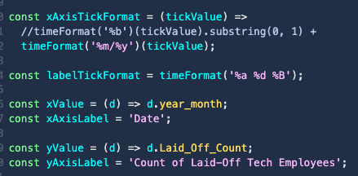
Figure 12: Axes Creation in d3.js

Slide 28
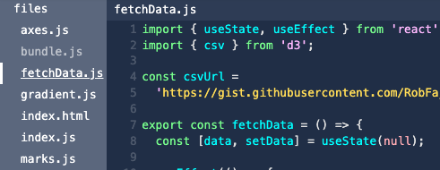
Figure 13: Data Pulled from Gist File Locations

Slide 29
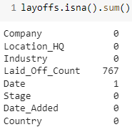
Figure 14: Layoffs Null Values

Slide 30
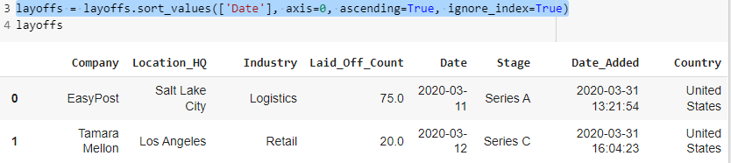
Figure 15: Layoffs Sorted by Date

Slide 31
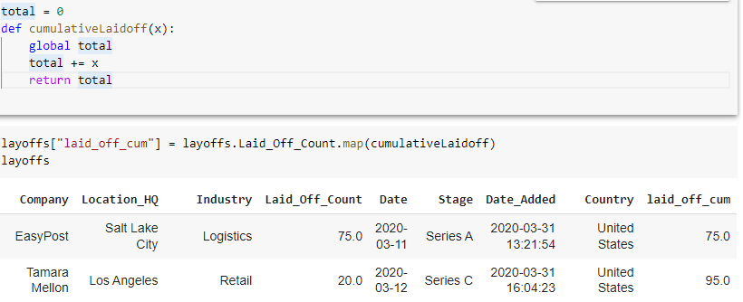
Figure 16: Layoffs Cumulative

Slide 32
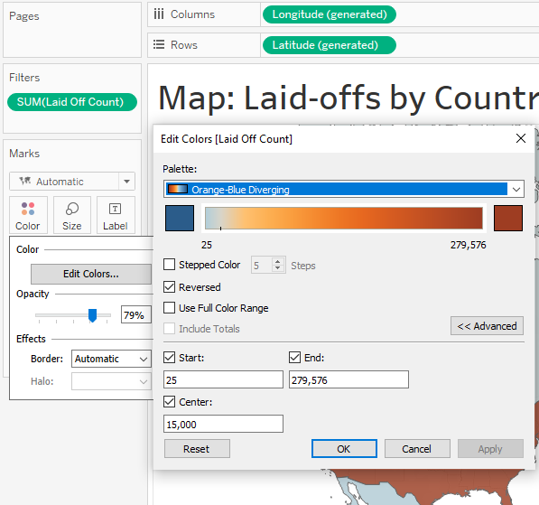
Figure 17: Map of Layoffs by Country

Slide 33
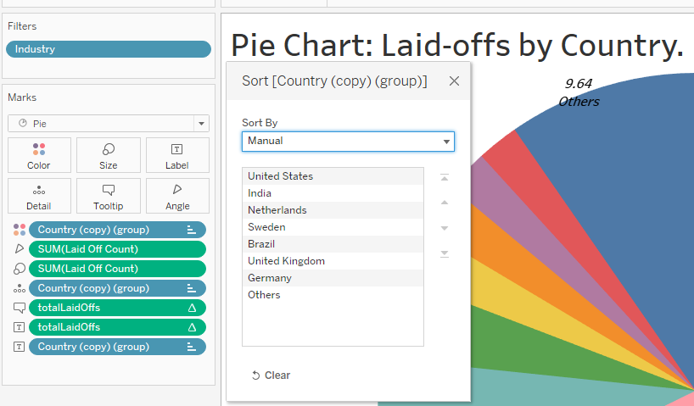
Figure 18: Pie-Chart of Layoffs by Country

Slide 34
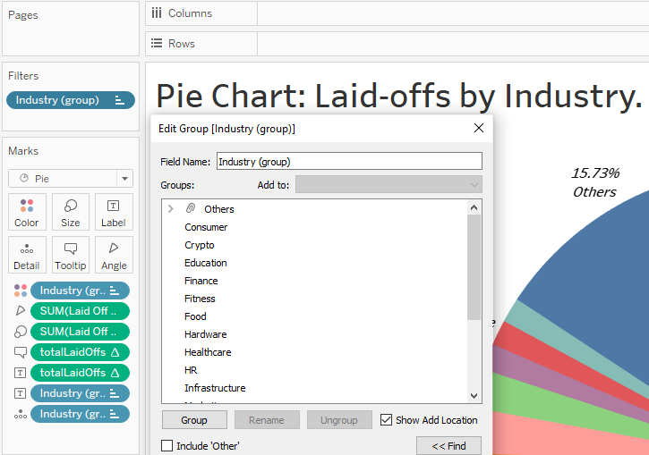
Figure 19: Layoffs by Industry

Slide 35
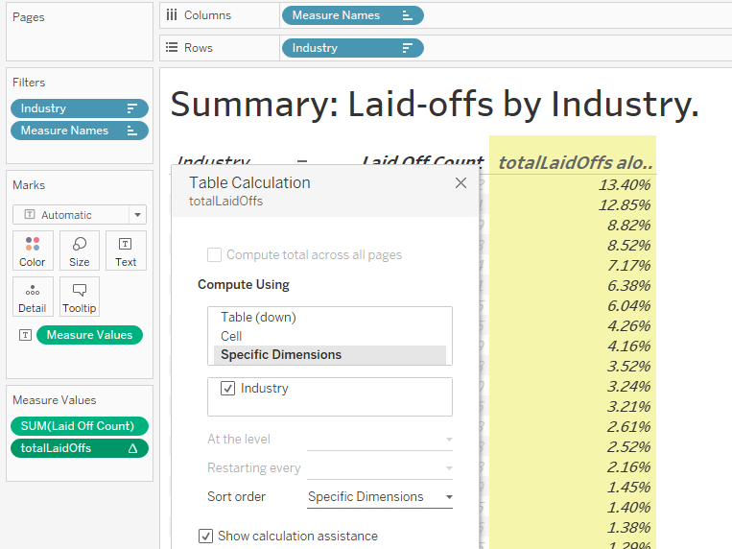
Figure 20: Summary of Layoffs by Industry

Slide 36
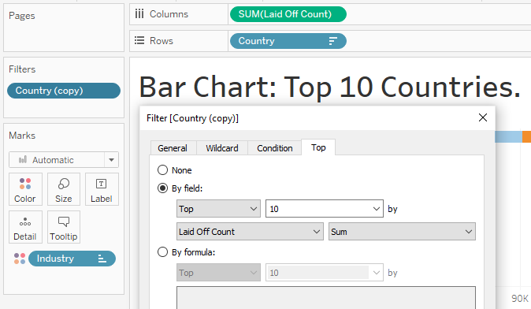
Figure 21: Bar Chart of Top 10 Countries

Slide 37
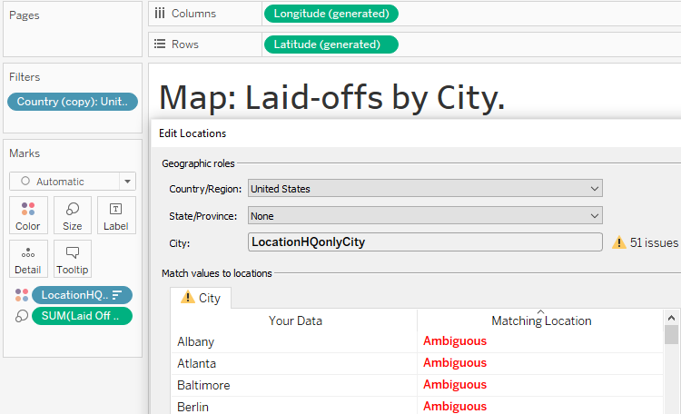
Figure 22: Map of Layoffs by City

Slide 38
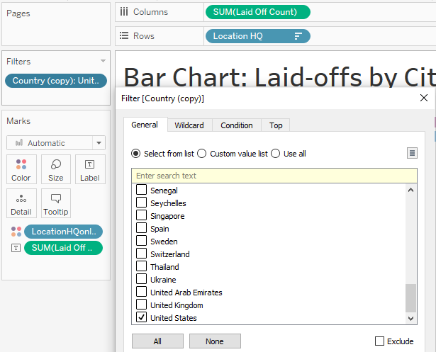
Figure 23: Bar Chart of Layoffs by City

Slide 39
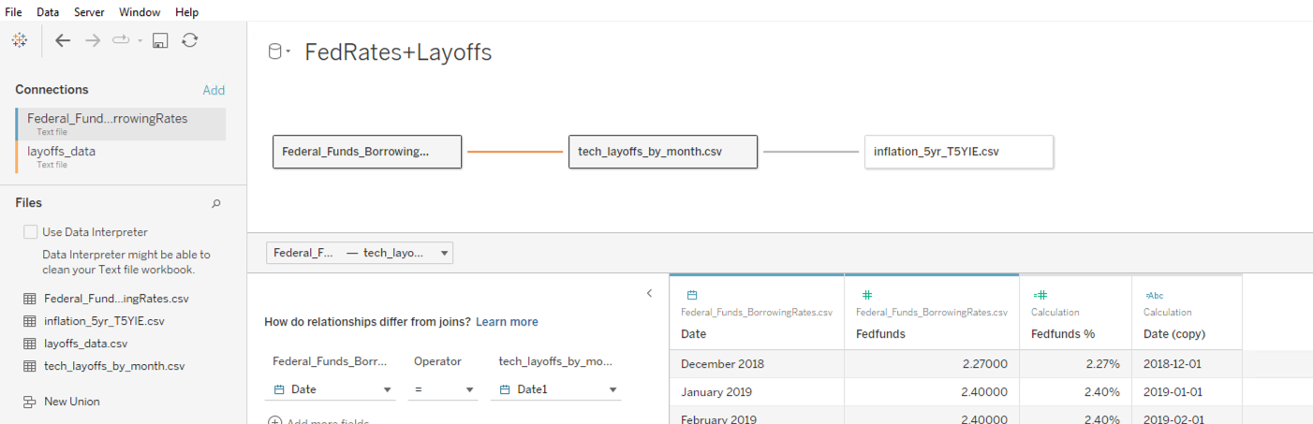
Figure 24: Building charts for each dashboard that will eventually have filters

Slide 40
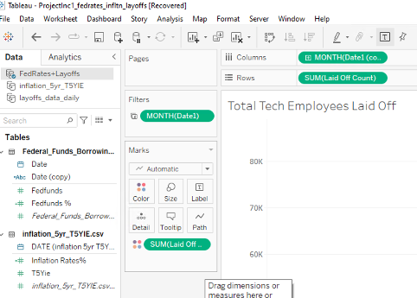
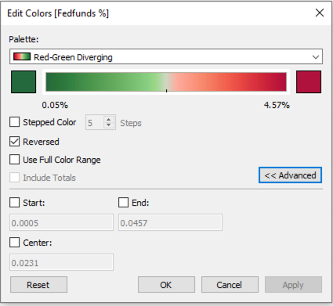
Figure 25: Pop Up of Tableau Marks to Edit Colors

Slide 41
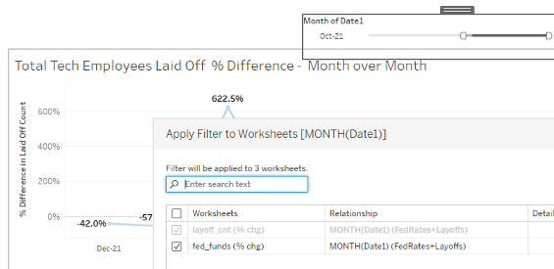
Figure 26: Example of Applying Filter to Both Sheets

Slide 42
Figure 27: Designing an dashboard filter action to select cells in the crosstab from left, and filter the charts on the right

Slide 43
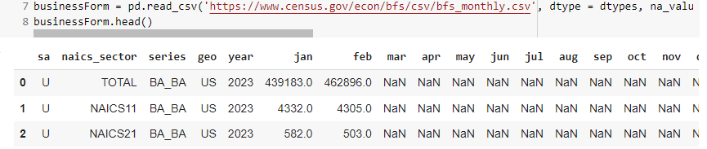
Figure 28: Business Application Dataset

Slide 44
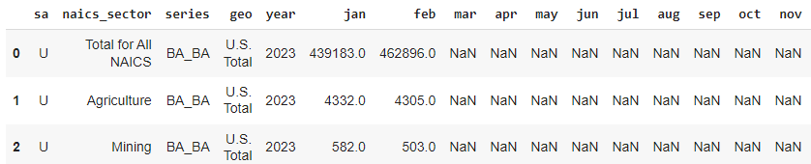
Figure 29: Verbose Business Application

Slide 45
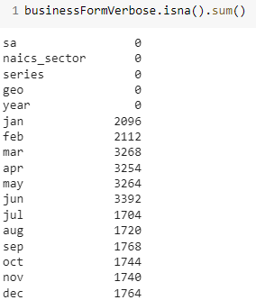
Figure 30: Business Application Null Values

Slide 46
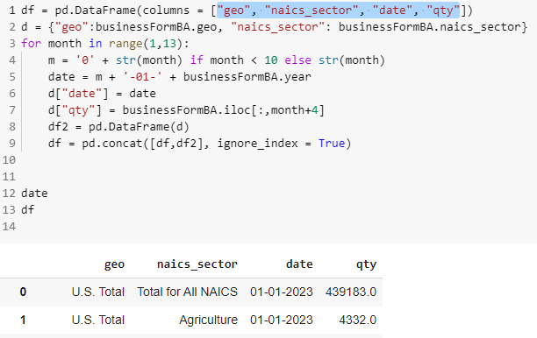
Figure 31: Business Application Concatenated Over Rows

Slide 47
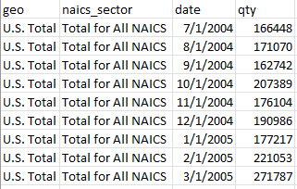
Figure 32: Business Applications Final Architecture

Slide 48
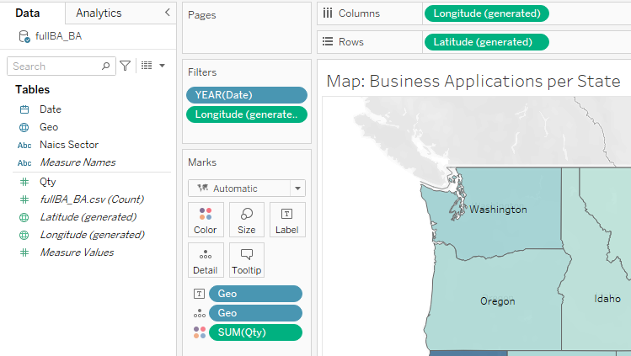
Figure 33: Map of Business Applications by State

Slide 49
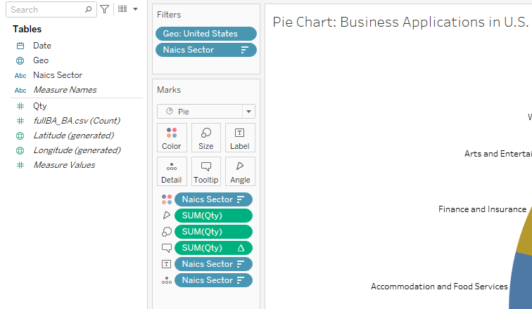
Figure 34: Pie Chart of Business Applications by State

Slide 50
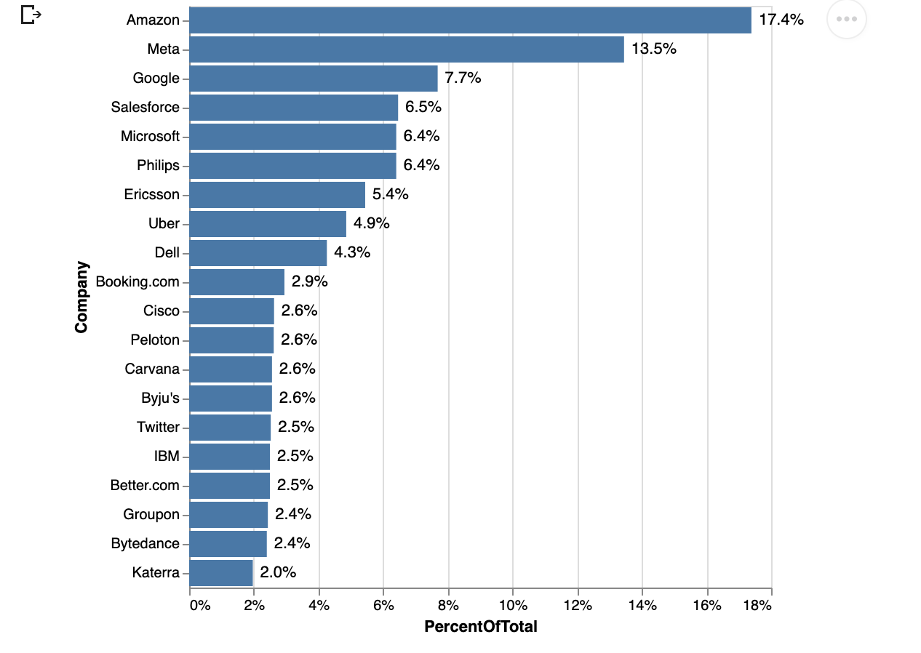
Figure 35: % of Total Layoffs by Company (Altair)

Slide 51
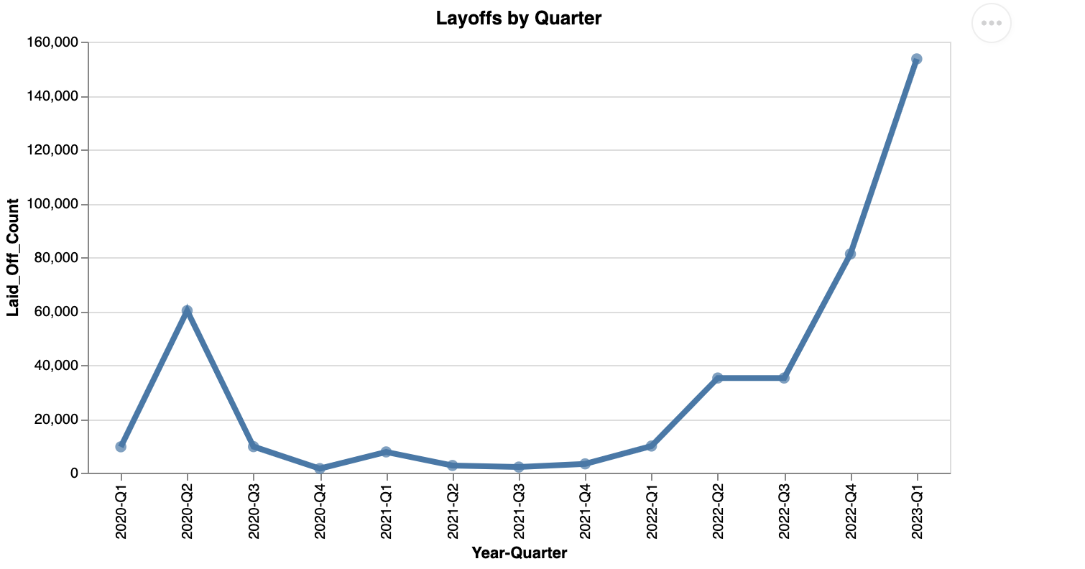
Figure 36: Layoffs Over Time by Quarter – Line Chart (Altair)

Slide 52
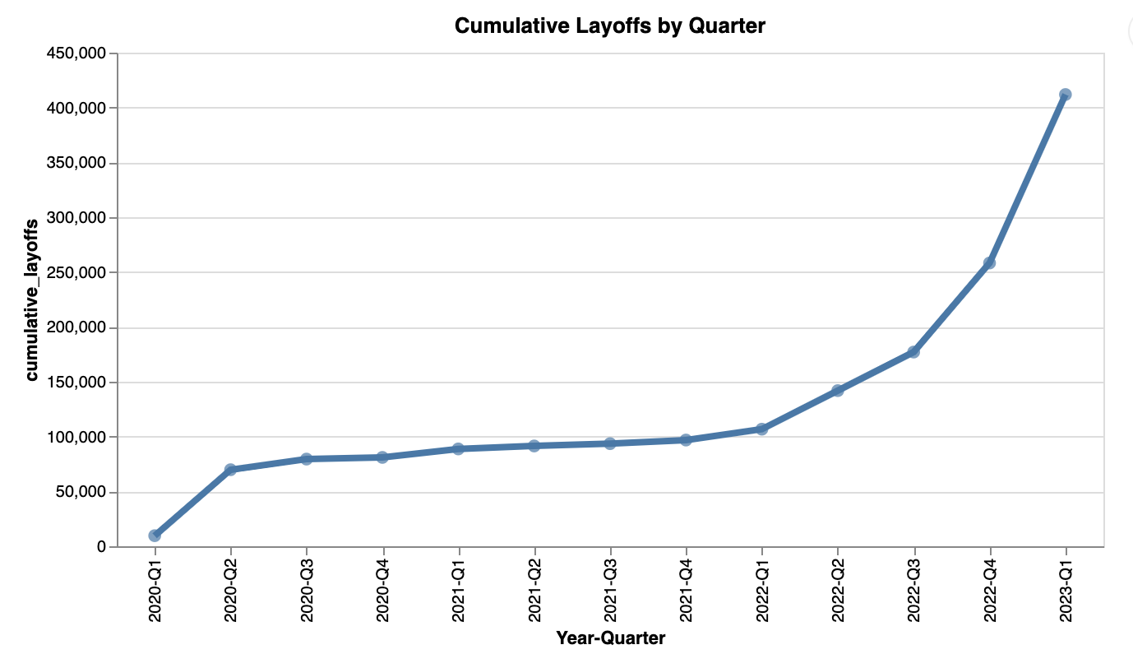
Figure 37: Cumulative Layoffs by Quarter – Line Chart (Altair)

Slide 53

Figure 38: Cumulative Layoffs by Quarter – Step Chart (Altair)

Slide 54

Figure 39: Inflation Chart using d3.js

Slide 55

Figure 40: Inflation Chart using Tableau

Slide 56

Figure 41: Fed Rate in Tableau

Slide 57

Figure 42: Fed Rate to Tech Layoff - Count

Slide 58
Figure 43: Fed Rate to Tech Layoff – Month over Month Precent Change

Slide 59

Figure 44: Fed Rate to Tech Layoff – Month over Month Precent Change

Slide 60

Figure 45: Filter and Highlight Implementation for Search Query and Derive in Tableau

Slide 61

Figure 46: Search and Query Derive: Layoff counts by company, location (SF) and derive fed rates

Slide 62
Figure 47: YOY Comparison for Fed Rates, Inflation Rates, and Layoffs, in Tableau

Slide 63

Figure 48: YOY% Change for Inflation, Fed Rates and Borrowing Rates

Slide 64

Figure 49: Layoffs and Business Applications Trends

Slide 65

Figure 50: Business Applications Trends by State

Slide 66

Figure 51: Unemployment Rate History

Slide 67

Figure 52: Rate of Unemployment During the Pandemic

Slide 68

Figure 53: Map BAD

Slide 69

Figure 54: PieLaid

Slide 70

Figure 55: MapPieCountry

Slide 71

Figure 56: MapLaidCity

Slide 72

Figure 57: Total Layoffs Percentage by Funding Stage Horizontal Bar Chart

Slide 73

Figure 58: Percentage of Total Funding and Percentage of Total Layoffs Scatter Plot

Slide 74
VizHub Links
Line Chart: Laid-offs over the world https://vizhub.com/bmurill2019/5144791ad73b4df990a76c8d8359a543
https://gist.githubusercontent.com/bmurill2019/05d7e985f5505edb856811f6bd71b077/raw/c4b8bf3c8399c9658a8584c353f14ebd1978f9d3/layoffsCleaned.csv
Line Chart: Cumulative Laid-offs https://vizhub.com/bmurill2019/be94835b2ee847c8b12e4d1a78869fe5
https://gist.githubusercontent.com/bmurill2019/05d7e985f5505edb856811f6bd71b077/raw/c4b8bf3c8399c9658a8584c353f14ebd1978f9d3/layoffsCleaned.csv

Slide 75
VizHub Links
Line Chart: Business Formation U.S. https://vizhub.com/bmurill2019/d99202b99d1f43ddb7311b8251ec21cb
https://gist.githubusercontent.com/bmurill2019/71b63ac1db3ea4ad4b64a6bd53877c12/raw/0fb712465989cae84a3be86e46ad844b4fa70aa5/businessFormUSAllNAICS.csv
Line Chart: Information Business Formation U.S. https://vizhub.com/bmurill2019/00a7344255344ddcb1080a14d957b653
https://gist.githubusercontent.com/bmurill2019/89a24a0f0796d9fe4a628ba3793178da/raw/04006fe001c20538010f611ee2fc650737d0bdcd/businessFormUSInformation.csv

Slide 76
VizHub Links
Line Chart: Business Formation California https://vizhub.com/bmurill2019/b0b70a91f699436486d465c19685ea3a
https://gist.githubusercontent.com/bmurill2019/cb6ed571ed6fd50d4dd26fb5605bc3ca/raw/416c5b431a6a732b234a4a45526f5cab6b44acbf/businessFormCalifornia.csv
Line Chart: Business Formation Florida https://vizhub.com/bmurill2019/a1ac3dff0c2e401a981270a0392bb005
https://gist.githubusercontent.com/bmurill2019/98d40b71323c4c6c3343c4bbf4baae78/raw/c052e9624e8dd46b757d47aea24be399de313f96/businessFormFlorida.csv

Slide 77
VizHub Links
Line Chart: Business Formation New York https://vizhub.com/bmurill2019/36bef157d93d439eb7062360f9a0e5c1
https://gist.githubusercontent.com/bmurill2019/85d2d20e48aeb2e517a2709f0a4cecb8/raw/c182437577773f16cf6e5f5f521dcf13a72952a4/businessFormNewYork.csv
Line Chart: Business Formation Texas https://vizhub.com/bmurill2019/24aac202e7e54ee796f4e6ae2d631f8d
https://gist.githubusercontent.com/bmurill2019/8e44c8f14eaa333b6e6efdbc21798674/raw/a74b765c5aec90bb9a5db517c1879edf010efd06/businessFormTexas.csv

